Slide 1

MuleSoft – Discussion
Troubleshoot and Usecase 2022 | May 9th Online
Vikash Sharma

Slide 2

Troubleshoot
Troubleshoot

Slide 3
Troubleshoot
How to troubleshoot the application
Run the Application
Error on Console:
# java.lang.OutOfMemoryError: Java heap space # -XX:OnOutOfMemoryError="taskkill /F /PID %p“ # Executing "taskkill /F /PID 24712"... JVM exited unexpectedly. Automatic JVM Restarts disabled. Shutting down
Initial Analysis
Above error clearly states that JVM got disabled of memory Out of exception. This error occurs because of Heap memory was exhausted

Slide 4
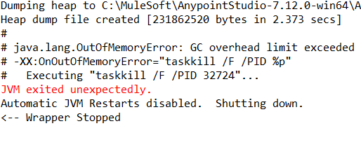
Troubleshoot
How to troubleshoot the application
Troubleshooting steps
1. Configure the path in wrapper.config file to create the heap dumps
wrapper.java.additional.19=-XX:HeapDumpPath= C:\MuleSoft\AnypointStudio-7.12.0-win64\AnypointStudio\plugins\org.mule.tooling.server.4.4.0.ee_7.11.0.202203290350\mule\logs
2. Run the mule application again.
3. Now the heap dump is generated when the application again fails.

Slide 5
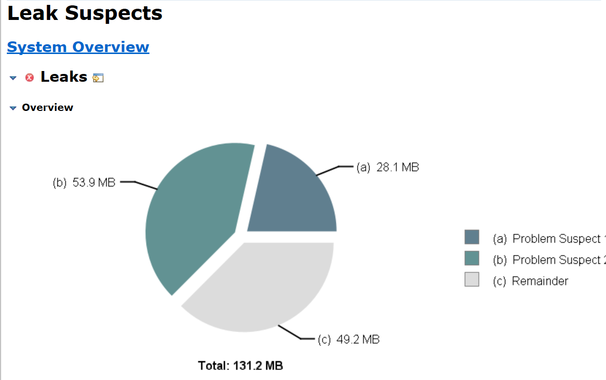
Troubleshoot
Root Cause:
Troubleshooting steps
Collect the heap dumps HPROF file and open the file using the Memory Analyzer tool.
Issues highlighted was Memory leakage.

Slide 6
Troubleshoot
Root Cause:
Analysis
Memory Analyzer tool logs its clearly states that this issue is because of memory leakage.
Analyzed the mule Application can could see there are 2 schedulers running.
Scheduler 1: Publishing the message to the VM queue in every 1000 ms.
Scheduler 2: Subscribing the message in every 5000 ms.
Threads were getting to pill up as publishing rate was greater than consuming rate.
To do analysis little deeper we started changing the subscriber scheduler occurrence time slowly.

Slide 7
Troubleshoot
Root Cause:
Resolution
Make the changes in the mule Application so that consumer can publish the message as soon as the publisher publishes the message
In this case when we decrease the scheduler timing from 5000 ms to 2000 ms and re-run the process . Mule App started running without any error for some time and then in between we started getting max concurrency error.
Message: Flow "troubleshooting-exerciseFlow1" is unable to accept new events at this time. Reason: MAX_CONCURRENCY_EXCEEDED
This error was seen because number of threads in subscriber service was configured as 1.
To solve this we need to increase the number of concurrent threads.

Slide 8
Troubleshoot
Root Cause:
Resolution
In this case decrease the scheduler timing from 5000 ms to 1000 ms and re run the process . Mule App started running with out any out of memory Exception.
Another way to handle this is to increase the VM memory argument to some higher value so that what ever the instance are getting generated heap memory should be able to handle it.
In this case as there was nor resource crunch, Reverted all the changes done in Mule App and change the VM arguments with below value –Xmx512m -Xms512m.
Run the mule App again. With higher memory allocated to the heap it worked smoothly

Slide 9
Troubleshoot
Root Cause:
Recommendation:
Analyze the application before allocating the resources to them.
Analyze the memory foot prints at different stages of application.
While doing the deployment we have to see what is the configuration we are choosing for the application on on premise or on cloud

Slide 10

Use Case
Energy Utility Usecase

Slide 11

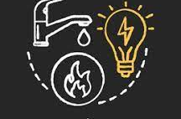
Acme International: Making Life Easier
Managing Energy
Transforming Life

Slide 12
Digitalization of Utility Services
Problem Statement:
Acme International wants to provide the platform to the customer where the customer can signup and use the available services. With this platform Customer want to integrate their different system like Salesforce, Databases and many more, using integration platform “MuleSoft”.
Once the system are integrated, users of the portal can perform some of the below actions
Signup on the portal
Apply for Energy Bill
Generate the bill on Demand
Pay the Bill online
Check the tariff plan
Subscribe for newsletter

Slide 13
Overview
Flow chart
Utility Login Page
Login with credentials
Check water / electricity bill
Check water / electricity bill
Download the payment invoice
Existing User
yes
Download the bill invoice
Check the payment history
Update personal details
Check billing history
No
Provide the details and sign up

Slide 14
Digitalization of Utility Services
Business Use case Mapping to Technical Use Case
Business Use case | Technical Use Case
Self-service portal | Using Salesforce CRM to register the customer details
View bills | Using Salesforce and MongoDB REST APIs to get the details
Pay bills | Integrating with third-party payment gateway APIs
Download bills | Using Salesforce, MongoDB APIs and transform using Data weave
Subscribe for alert notification for due bills\Newsletter | Using Messaging features
Handling Error | Global error handler to handle all kinds of error

Slide 15
Digitalization of Utility Services
Technical Use Case:
Onboard: Self-service portal
Update your personal data
Apply for new electric or/and water bill
View your bills
Download bills
Pay your bills
Download invoice
Analyze your bill consumption

Slide 16
API Led Integration
Customer centric Use Case:
Technical Usecase | Microservice- API in MuleSoft | System Integrated
Onboard: Self-service portal | Signup API service- Integrating with SF | Salesforce
Apply for Utility meter | ApplyforMeterConnection | MongoDB
Generate Bill | GenerateBillForCustomer | Third Party System, MongoDB
Pay your Bills | PayBill | Third Party system
GetTarrif Details | EnergyPlanRates | MongoDB
Analyze Bill Consumption | AnalyseBill | MongoDB, Azure Storage
Subscribe Newsletter CustomerSubscribeNewsLetter AzureServiceBus, MongoDB

Slide 17
Digitalization of Utility Services: Process Types used
Microservices Developed
Real Time API:
API exposed to customer for signup process
API exposed to update the personal details of customer
API exposed to check the tariff plans for their utilities.
API exposed to generate the bill on Demand
API exposed to pay the Bill
Batch processing
Monthly generate the customer Bill
Sending email notification to customer when the bill is generated

Slide 18
Digitalization of Utility Services: Process Types used
Microservices Developed
Publish subscribe:
Customer Subscribe Newsletter
Reusable Framework:
Common Logger framework
Global error handler

Slide 19
Digitalization of Utility Services
System Integrated
Salesforce CRM
Mongo DB
Azure Service bus
Azure storage
Third Party API’s.

Slide 20
Questions ??

Slide 21
Thank you….

